Slide 1

Supercharge your AI Agents with MCP in Action

Slide 2




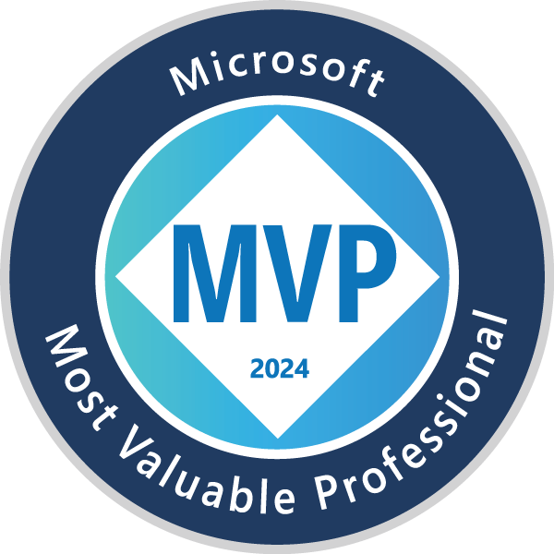
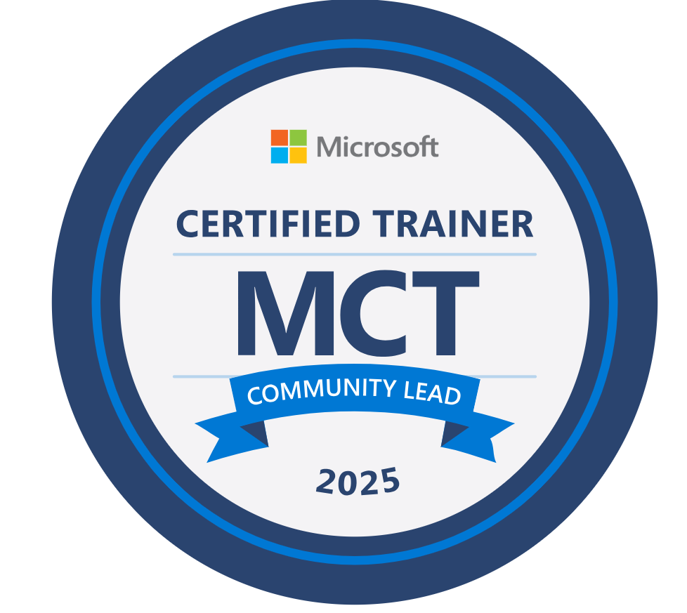
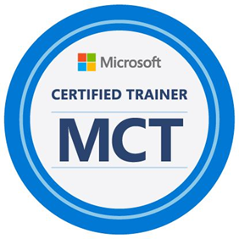



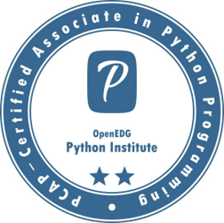
Microsoft Most Valuable Professional
Microsoft Certified Trainer Community Lead
Microsoft Certified Trainer
Microsoft Learn Expert
15 X Microsoft Certified
Author & Global Speaker
Mentor & Blogger

Slide 3


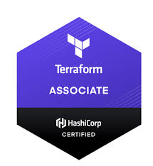
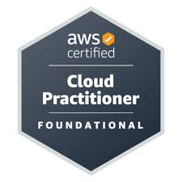

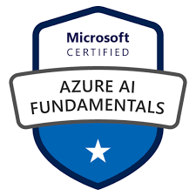

Kesigan Anbalagan
Principal Engineer At Comcast
M.Tech in Data Science & Engineering BITS Pilani
2 X Azure Cloud Certified Professional
2 X AWS Cloud Certified Professional
Hashi Corp Terraform Certified Associate
Mentor
Speaker

Slide 4
Agenda
What is Model Context Protocol (MCP)
MCP Architecture
Core Components of MCP
Building MCP Server with hands-on
MCP Inspector
Testing MCP Server Application using MCP Inspector with hands-on
Real World Impact

Slide 5
What is MCP?
MCP is an open protocol that standardizes how applications provide context to LLMs.
MCP provides a standardized way to connect AI models to different data sources and tools.

Slide 6
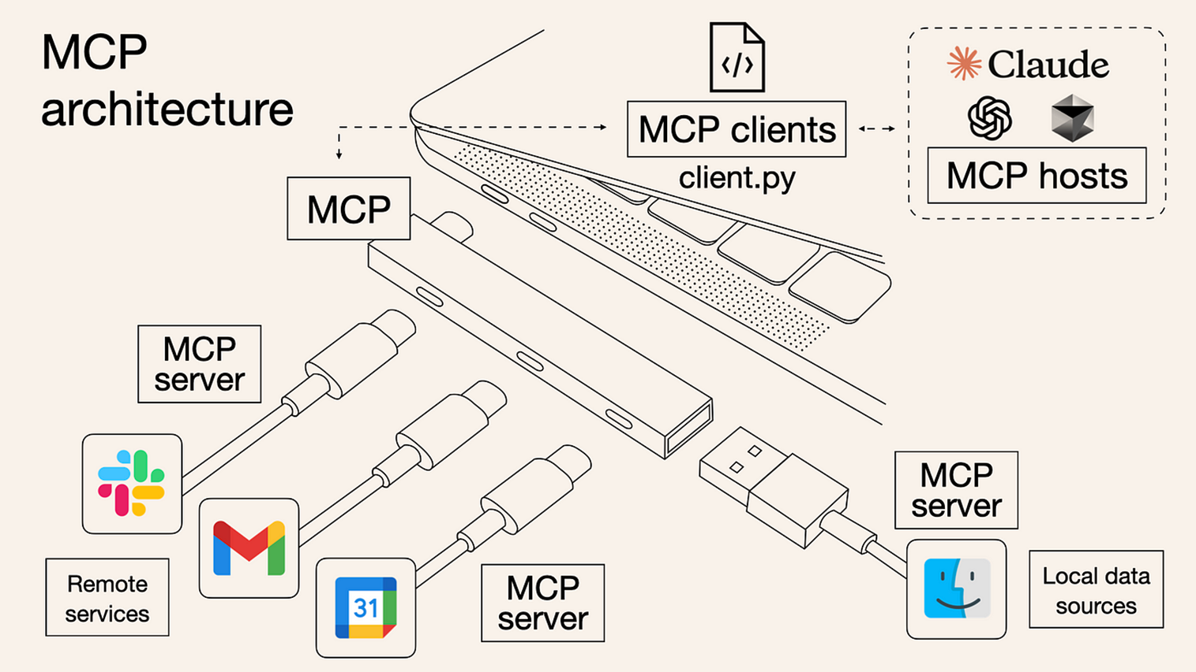
MCP Architecture

Slide 7
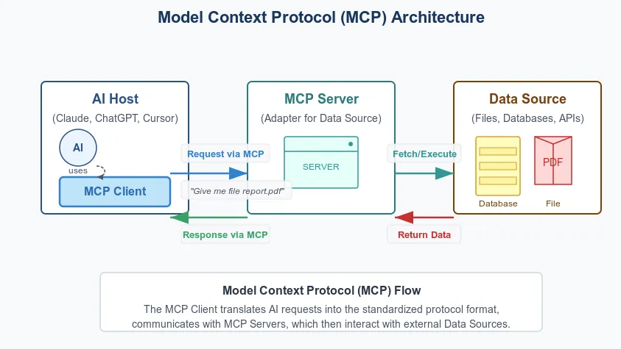
MCP Internal Architecture

Slide 8
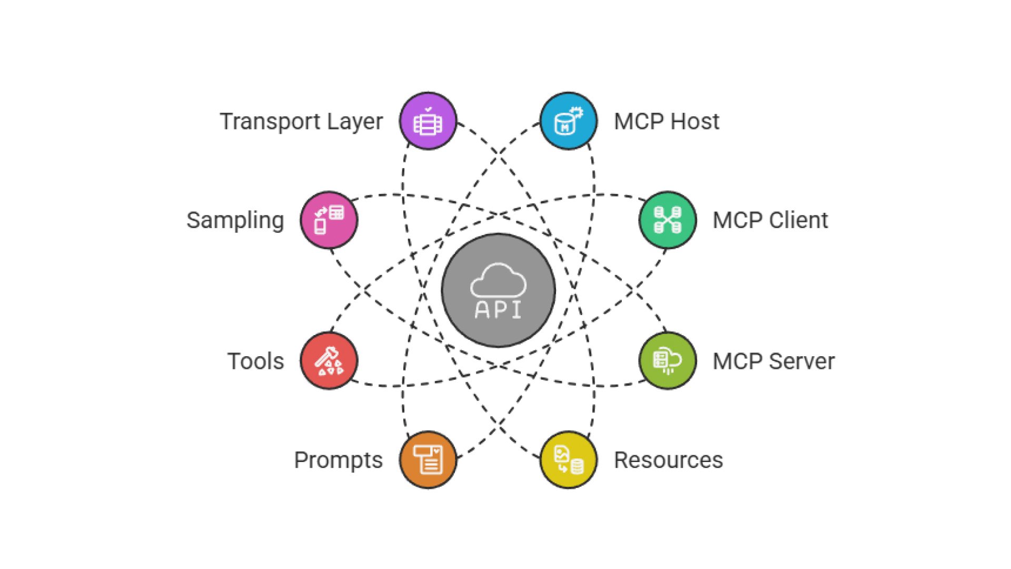
Core Components of MCP

Slide 9
MCP Inspector
MCP Inspector is an interactive developer tool
For Testing and Debugging MCP Servers.

Slide 10
MCP Inspector
Inspect, debug, and validate MCP servers/clients fast
For Developers, SREs, and Platform Teams

Slide 11
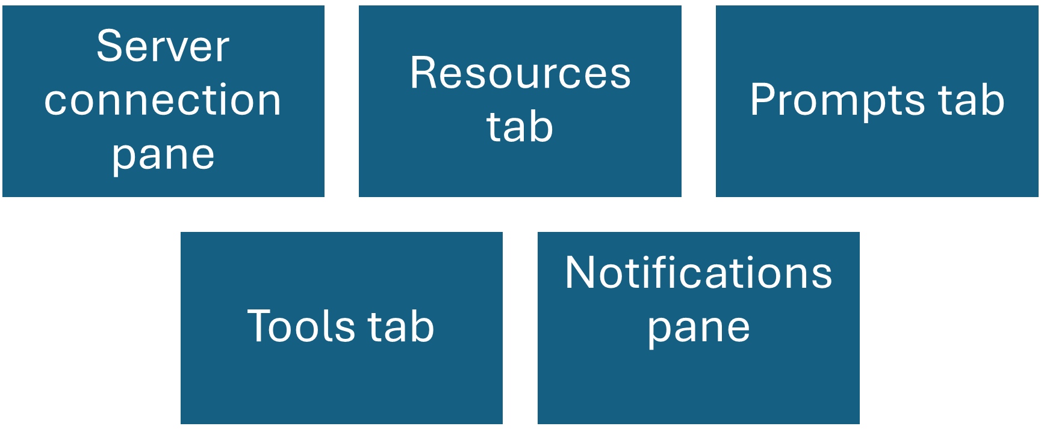
MCP Inspector Key Features

Slide 12
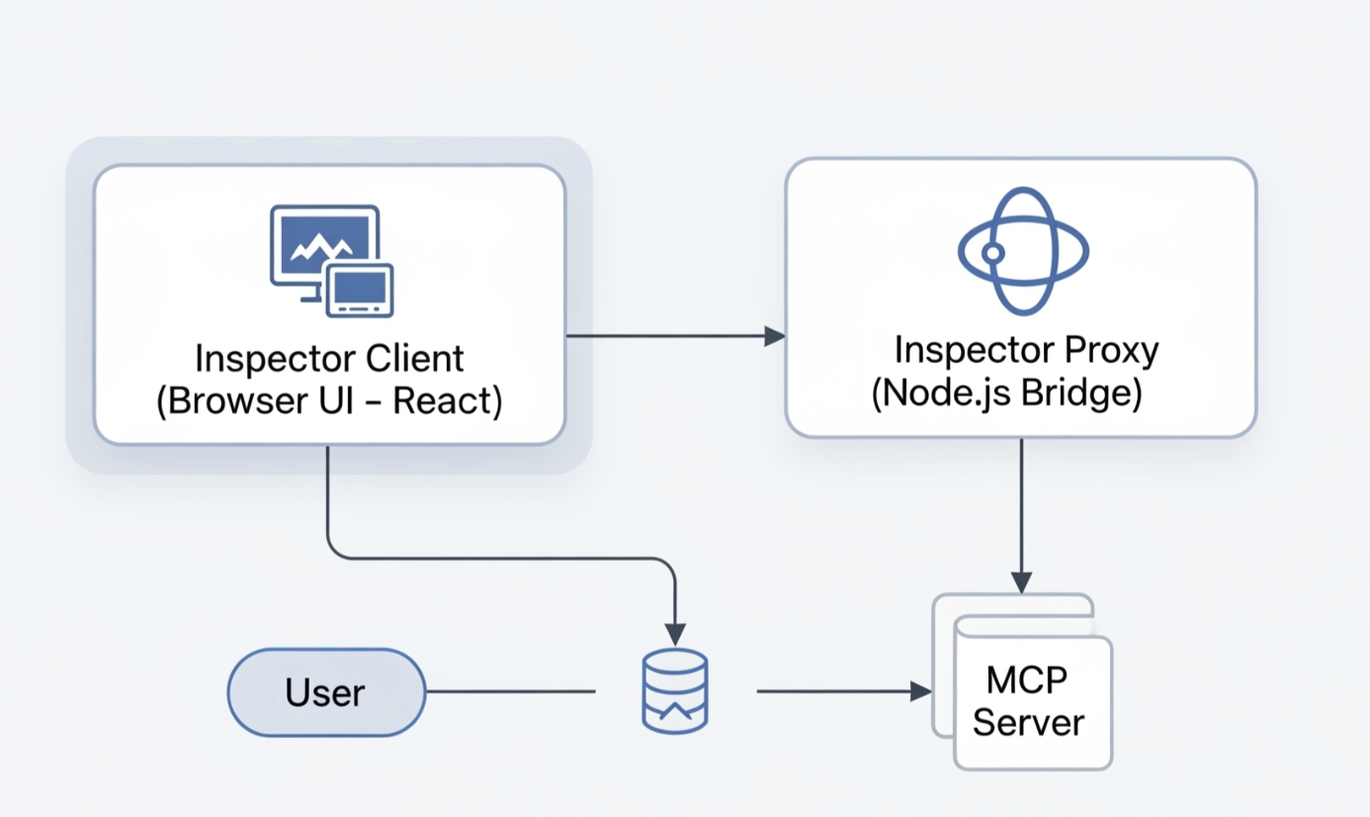
MCP Inspector how it Works?

Slide 13
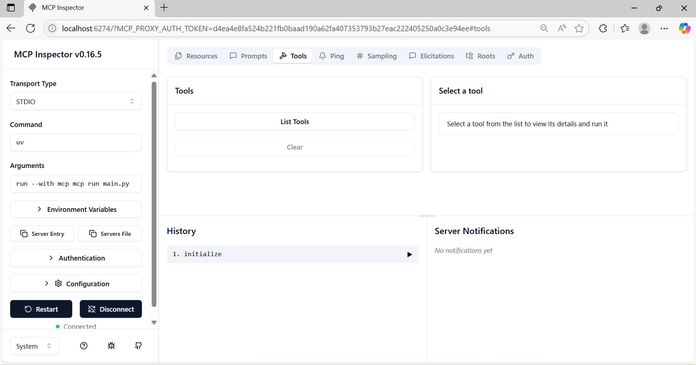
MCP Inspector Interface

Slide 14

Social Handles for Connect

